Slide 1
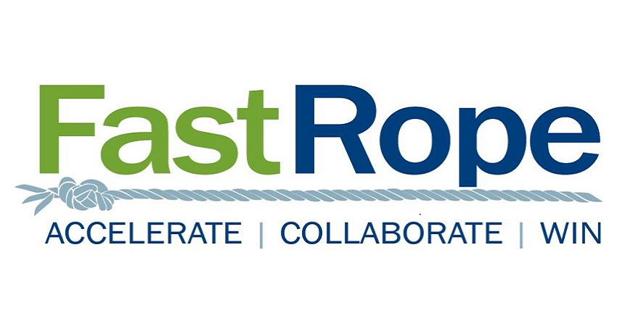
Fast Rope Capability Exchange
Sharing Capability with Industry (Large and Small), and Government
David Hart, First Fast Roper: david.hart@jjrsolutions.com
Joni Ahlers, Fast Rope Facilitator: joni.ahlers@definitivelogic.com

Slide 2
About Fast Rope
What Fast Rope is…
Founded Sep 2009
Dayton, NCR, O’Fallon, San Antonio, Southeast
300 plus members.
Industry to Industry forum.
Informal round table format
Information and relationships are the currency.
People are members, not companies.
Focus on quality…not quantity.
https://fastrope.org/
What Fast Rope is NOT…
Not a huge professional industry association.
Not a small focused pursuit team with NDAs.
Not a diverse mastermind group.
Not a high-volume B to B networking group.
Not a place to be a taker/sponge.
A forum with trusted Industry professionals that meet regularly to share market information and seek teaming opportunities, utilizing an informal Round Table format, and collaboration portal.

Slide 3
Fast Rope Capability Exchange
- Exchange Overview -
Gather Industry both small and large, along with government reps, and efficiently share capabilities, short and powerful
Reoccurs the First Wed of each month, Noon to 1:00 Eastern.
Core topic thread is very broadly around IT/Technical Capabilities.
The session runs 60 minutes, total, hard stop on the hour.
7 contractors get 7-minute presentations, 3 slides max.
No Q&A, broadcast mode only.
No cost to attend, companies presenting must be FR members.
Forum Link: https://fastrope.wildapricot.org/Teaming-Forum

Slide 4
POC 12.1.2021
Presentation POC
BuddoBot Inc. – Will Swann wswann@buddobot.com
CGI – Aaron Allgeyer aaron.Allgeyer@cgifederal.com
IsoBar – Jon Clayton jon.clayton@us.isobar.com
Objectivity – Kim Wizer kwizer@objectivity.com
Petra Cyber Technologies – Linda Kinkead l.kinkead@petracybertech.com
Government POC
AFLCMC – Luke Schultz luke.schultz@us.af.mil
AFMC – Jeffrey Mellot jeffrey.mellott.1@us.af.mil
SBA – Thomas Krusemark thomas.krusemark@sba.gov
Reach out directly to follow up. Here’s the link to monitor the Capability Exchange Forum
https://fastrope.wildapricot.org/Teaming-Forum
This forum is open to all government individuals and agencies.

Slide 5
Company Overview
BuddoBot is an 8(a) Veteran Owned Small Business. We are a team of talented problem-solvers, subject matter experts, and managers that specialize in Cybersecurity, IT, and Infrastructure services. We are a genuine team that understands the need for quality and delivery at an affordable cost.
Cloud Strategy & Readiness
Cloud Architecture & Migration
Cloud Operations and Maintenance
Cloud Optimization
Cybersecurity Operations
Penetration Testing
Reverse Engineering/ Malware Analysis
Incident Response
Digital Forensics
Simulated Phishing
Mobile Application Security
Vulnerability Assessments
Security Awareness Training
Certification & Accreditation
Risk Management Framework
Independent Verification & Validation
Cyber Risk Assessments
Cyber Governance

Slide 6
Cyber Security
Offensive Cyber
BuddoBot has the capability to ensure that your networks and data are prepared for WHEN threats happen
Penetration Testing
Insider Threat Training
Vulnerability Management
Incident Response
Prepare your organization to be able to respond effectively for an attack event
Ensure all levels of the organization are aware
Defensive Cyber
Risk Management
Certification and Accreditation
Risk Management Framework (RMF)
NIST 800-171 and FISMA Compliance
Customers
Department of Treasury - Financial Crimes Enforcement Network
Army North (ARNorth)
USAF Lifecycle Management (formerly Air Mobility Command)
Marine Corp Systems Command
MedStar Health

Slide 7
Needs
Needs:
Small Business Partners with ISO9001, ISO27000, CMMI DEV/SVC Level 3 for GSA Polaris
Small WOSB/8a companies interested in being an All Small Mentor Protege
Physical Presence – Worldwide Impact
Will Swann
VP, Growth & Strategy
WSwann@BuddoBot.com
571.642.1003
4 Eagle Center, Suite 2, O’Fallon, IL 62269
4000 Legato Road STE 1100 Fairfax, VA 22033

Slide 8
CGI Federal Overview
Insights you can act on
Aaron Allgeyer
Director, Defense Practice 1 Dec 21
aaron.allgeyer@cgifederal.com 202.809.3130

Slide 9
~7,000
Dedicated professionals
CGI Federal | by the numbers
100+
Federal clients
Level 5
CMMI certification
75+%
Employees are shareholders
9.7/10
Client loyalty score
95%
On-time, on-budget project delivery
#31
₁st
20-30%
Top 100 Fed Contractors
Washington Technology (2020)
Large provider to receive FedRAMP provisional authority to operate federal cloud services
Savings on high-quality IT services, enabled by innovative on-shore model
© 2021 CGI Inc.
External

Slide 10
CGI Federal | range of services and differentiators
End-to-end services | Strategic IT and business consulting | Systems integration | Managed IT and business process services
 | Intellectual property solutions and services as value creation accelerators for clients
Differentiators | Client-proximity model
 | Global antenna for the benefit of our clients
 | Local and global expertise by industry
 | Global delivery network
© 2021 CGI Inc.
External

Slide 11
CGI Federal | delivering federal digital transformation
Digital insights
Automation and AI
IoT and Intelligent Machines
Leverage IoT to track and manage more than $13 billion worth of U.S. military assets
Cybersecurity
Protect against 43 million cyber attack incidents daily on military and intelligence infrastructure
Cloud
Enable analytics on over 22 terabytes of healthcare claims data
Automate collection of environmental data, including from mobile devices and sensors
$100 million in secure cloud solutions for federal agencies
© 2021 CGI Inc.
External

Slide 12
CGI Federal | committed to delivering mission success
Collect and disseminate terrorism and cyber threat information in support of multiple law enforcement functions
Leveraging an RPA bot solution, reduced a 4-week manual process to 2 hours for the U.S. Department of Agriculture
Manage the financials of 100+ federal agencies
Support DHS’s mission to prepare for, prevent, and respond to domestic emergencies – keep America safe – by supporting mission critical applications
Process 5 million U.S. visas for 70 countries
each year in support of the
U.S. Department of State
Support production of all 20 million U.S. passports issued each year by the U.S.
Department of State
$13 billion worth of government property is tracked for the U.S. Army, U.S. Navy and U.S. Marine Corps
© 2021 CGI Inc.
External

Slide 13
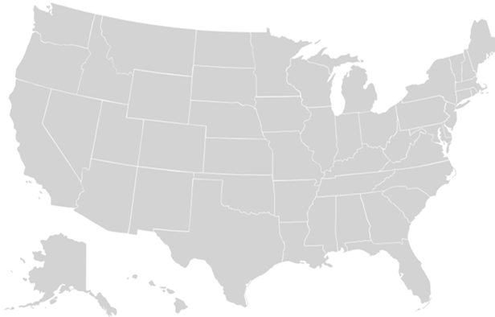
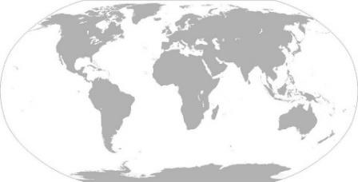
CGI Federal | geographical footprint
Buffalo
Cleveland
Albany
Gales Ferry
Sacramento
New York
Annapolis Junction
Oakland
Columbus
Baltimore
Ballston Crystal City Fairfax Manassas Reston Washington DC
San Ramon
Cincinnati
z
Fairview Heights
Lebanon
Norfolk
Knoxville
Durham
Lawton
Atlanta
San Diego
Tucson
Huntsville
Dallas
Hot Springs
Charleston
San Angelo
Belton
Albany
Lafayette
Orange Park/ Jacksonville
Austin
San Antonio
Tampa
Miami
+70 countries around the world
© 2021 CGI Inc.
U.S. Delivery Centers
External
6

Slide 14
CGI Federal | Contract Vehicle Options
GSA Alliant 2
GSA MAS Information Technology Category GS-35F-281DA
GSA MAS Professional Services Category GS-00F-302CA
GSA One Acquisition Solution for Integrated Services (OASIS) Pools 1, 2, 3, 4, 5a, 5b
NIH Chief Information Officer-Solutions and Partners 3 (CIO-SP3)
Army Cloud Computed Enterprise Transformation (ACCENT)
Army Software and Systems Engineering Services SSES NexGen
Centers for Medicaid & Medicare Services (CMS) Strategic Partners for Acquisition Readiness Contract (SPARC)
Centers for Medicaid & Medicare Services (CMS) Virtual Data Center
Department of Health and Human Services (HHS) Intelligent Automation / Artificial Intelligence (IAAI) Contract
Department of the Interior (DOI) Foundation Cloud Hosting (FCH) IDIQ
DHS CDM (Continuous Diagnostics and Mitigation) BPA
Department of Homeland Security (DHS) Eagle II
Department of Justice (DOJ) Cybersecurity Program Management BPA
Department of Justice (DOJ) Unified Financial Management System (UFMS) BPA
Department of State Development (DOS) Global Support Strategy (GSS)
Federal Bureau of Investigation (FBI) Solutions for Financial Systems (SoFS)
Federal Deposit Insurance Corporation (FDIC) ITAS II BOA
Government National Mortgage Association (Ginnie Mae) Software Development BPA
Library of Congress (LOC) Systems Development Life Cycle (SDLC) IT Support Services IDIQ
Library of Congress Legislative Branch Financial Management System (LBFMS) Shared Service
Navy Seaport-NxG
Navy NAVSUP PIRMDS2
Nuclear Regulatory Commission (NRC) GLINDA BPA
Social Security Administration (SSA) ITSSC IDIQ
U.S. Patent and Trademark Office SDI-NG
U.S. Postal Service (USPS) Information Technology Security Testing (ITST) IDIQ
Veterans Affairs (VA) Integrated Financial Acquisition Management System (iFAMS)
Veterans Affairs (VA) T4NG ID
The Army Information Technology Enterprise Solutions – 3 Services (ITES-3S) IDIQ via October 2021 Acquisition of Array Holding Company, Inc.
(aka Array Info Tech)
External 7
© 2021 CGI Inc.

Slide 15
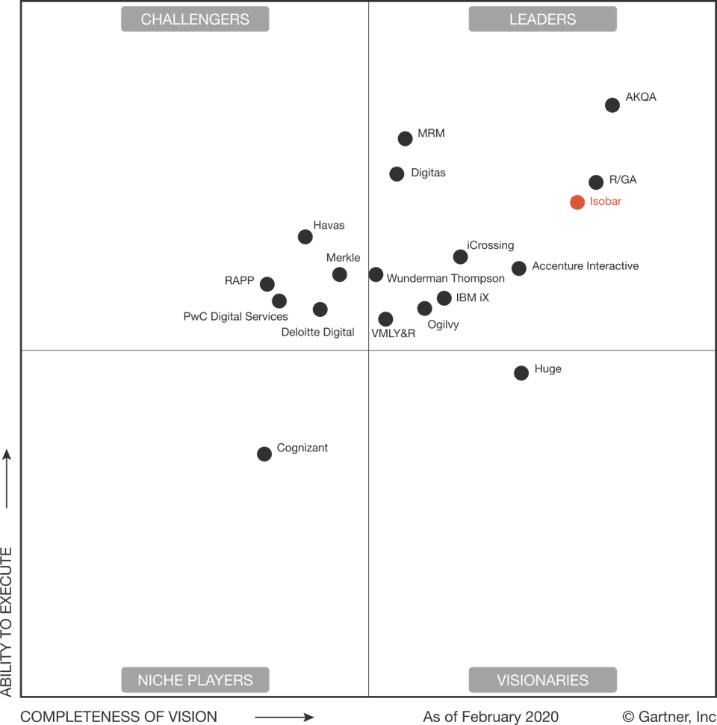
Six-time Gartner Magic Quadrant Leader for Global Digital Agencies
Our customers range from major brands to nonprofits to U.S. government agencies
We’re part of the Dentsu Network
We are a global agency that delivers experience-driven digital transformation
85
45
6500+
300+
Offices Globally
Countries
People
Awards
Top 10 Innovation Agency, strong performer in The Digital Experience Service Providers, 2017 and a Leader in Commerce Specialist Service Providers, 2018
Named as one of the Top Ten Most Innovative Companies in AR and VR
Named Digital Innovation Agency Network EMEA 2018 and Digital Network of the Year six times out of the last eight years in Asia
Notes:
We work with some of the world’s largest organizations across a diverse set of industries. We build trust with our clients through transparency and our focus on driving business success. We many long term client relationships due to this approach:
USAF - since 2001, we have provided mission critical strategy, user experience, design, and technical expertise to build secure applications that fuel daily communications, operations, and analysis. Our strategic partnership has led digital innovation across the Air Force.
Enterprise - since 2014, digital transformation across Enterprise and National brands with Alamo soon to follow
GM - since 2014, Isobar delivers digital advertising for GM. Elevating everyday banner ads into magazine-worthy spreads, we targeted GM's consumers at the sites they frequent with very dramatic—and highly effective—homepage takeovers.
HBO - since 2011, partnered with HBO to map out a comprehensive digital strategy, design visually immersive experiences, and develop bleeding-edge platforms that deliver TV everywhere to fans on their terms. From strategizing HBO's digital path to developing and designing their consumer-facing platforms, Isobar created a rich, intuitive, multi-channel experience that engages millions of fans.
Adidas - since 2011, digital marketing campaigns for basketball and running categories supporting multiple product launches. Strategy and design for new premium shopping experience currently in development (Isobar UK involved).
Bloomberg - 10+ year relationship to design and build multiple digital products that leverage terminal data to unlock new streams of revenue, products have spanned from fantasy sports apps, to subscription-based research tools for lawyers to products in the wealth management space.
Tivity Health - 5+ year relationship with Healthways that led to a now 3 year relationship with Tivity Health.
Wyndham. Destinations - (timeshare and vacation rentals division which is now a separate company), client for 3 years work spanning new product development and launch, emerging technology and innovation (VR work)
Pfizer and AstraZeneca - long-term Isobar Marketing Intelligence clients where we have done multiple research and segmentation studies.
Yum Brands (KFC and Pizza Hut), long term Isobar client in APAC for KFC. We helped launch their 5000 store leveraging digital innovations including ‘Dumi’ voice controlled A1 robot and self help ordering kiosks. Pizza Hut is a US client and we are working with them to revamp their mobile experience and incorporate AR into their product experience.
CocaCola - long term client for isobar China. Here is one example - https://www.isobar.com/gr/en/work/coca-cola-drama-coke/
S&P Global, Supercell, Lafayette 148 and Jet - all long term firstborn clients.

Slide 16
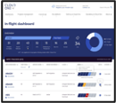
/ Our capabilities
Unparalleled digital & modernization capabilities
Experience Design
Application & Platform Development
Secure Cloud Solutions
Data Modernization
Cybersecurity
Marketing, Branding & Change Communications
Strategy & Program Management
Emerging Technology/Innovation
Artificial Intelligence/Machine Learning
Mixed Reality
CloudOne | USAF Portal | Data Services | Enterprise IT as a Service | eBOSS | Kessel Run
Commanding the US Air Force’s adoption of cloud computing. We stood up a dynamic cloud hosting solution for USAF's vast portfolio of mission applications. | One of the world’s largest Intranet portals takes flight. We redesigned and rebuilt the USAF Portal, one of the world’s largest intranets, providing 750,000 users access to information from 9,000 combined websites maintained by over 6,000 content managers. Our improvements led to annual cost savings exceeding $11M. | Pulling the Air Force’s many data sources into one powerful formation. The USAF Data Service is the #1 source of business analytics for the Air Force logistics community. Our efforts include the creation of 19 mission-critical applications for over 10,000 users, consuming over 36TB of data. | Rethinking the IT Customer Experience. We have worked with USAF’s IT division to provide strategic planning, customer service design, and program management for their ambitious initiative to modernize their IT service platform. | Transforming performance review and career planning for the United States Air Force. We streamlined and digitized the 40-year-old promotion board process used for every single one of USAF's enlisted airmen and civilian employees. | Revolutionizing software development. We supported the USAF in standing up DevSecOps and delivering software that enables enhanced combat capabilities.

Slide 17
Needs and Requests
Isobar needs partnerships! We do not have any IDIQs at this point.
Leverage our well-respected AF experience and our Commercial reach back.
Tap into our vendor partnership with Qualtrics for CX and Salesforce for modernization.
Point of Contact
Isobar / Public Sector is a wholly owned subsidiary of Dentsu a global digital agency.
Website: http://federal.isobar.com
Jon Clayton, Vice President of Business Development DoD
E: jon.clayton@us.isobar.com P: 334.399.7164
Jon Chaplin, Vice President of Business Development Civ
E: jon.chaplin@us.isobar.com P: 334.399.7164

Slide 18
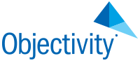
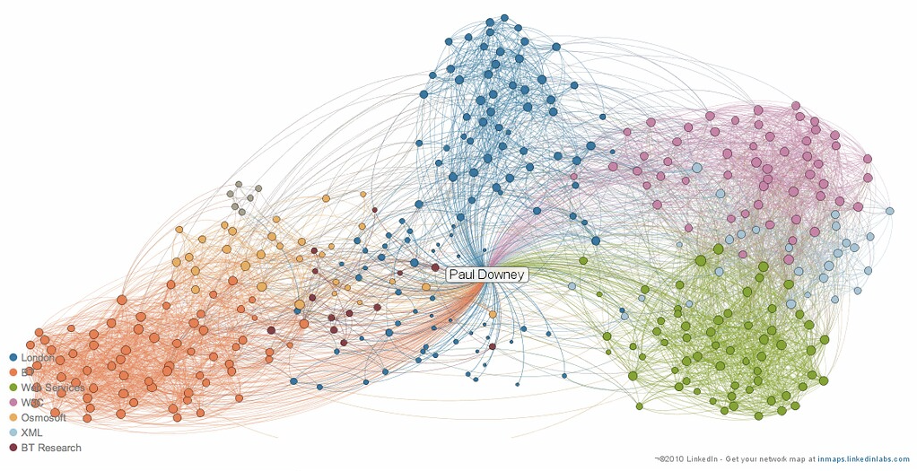
Technical & Functional Expertise
Objectivity, Inc. is a software company.
Objectivity builds and licenses database software products that enable the management of massive volumes of complex data with mission critical performance requirements.
Why graph databases?
Product Differentiators
Massively scalable, vertically and horizontally
Enables complex relationship analytics in near real-time
Supports graph analytic queries across hundreds of degrees
Able to ingest and connect billions of data items per hour
Based on our patented technologies
Objectivity/DB
InfiniteGraph
Data is becoming more connected
80% of analytics will be graph-based by 2025*
Graph databases can quickly find answers or connections in massive data sets.
Sample LinkedIn Connectivity Graph
* Source: https://www.gartner.com/smarterwithgartner/gartner-top-10-data-and-analytics-trends-for-2021

Slide 19
Past Performance
Key Government References:
Network Centric Collaborative Targeting
A distributed real-time targeting system that correlates multiple “views” of a target.
Integrates sensor feeds from heterogeneous military assets into a single common operating platform.
Dramatically accelerates and improves target identification and execution.
Analyst Support Architecture
A “GOTS” data fusion engine managed by the NRO.
Freely available to Government customers. (Requires purchase of Objectivity/DB License.)
Currently being deployed across the US Submarine fleet by five different integrators.
Objectivity/DB is currently used in several massively scalable data fusion/correlation and link-analysis systems in the DoD.
C4ISR
multi-intelligence data fusion
battlefield situational awareness
decision support systems
Telecom & Networking
Mobile Call-Detail Record
Cyber Security
Network Management Systems
Web and Mobile Ad targeting Systems
Financial Services
Regulation and Compliance
Asset Management
Cybercrime Prevention/Detection
Process Optimization
Manufacturing & Process Control
Distributed Configuration Management
Monitoring, Analyzing, and Responding
Manufacturing Execution Systems
Complex Systems Design
PLM Systems
Oil and Gas Exploration, Modeling
Ocean Mapping
Healthcare and Medical Equipment
Laboratory Equipment Management
Anesthetics Monitoring
Perinatal Monitoring Systems
Healthcare Records Management

Slide 20
Seeking…
Opportunities to Provide Technology to Solve Complex Data Problems
We are looking for projects that will be:
Managing massive volumes of data,
Supporting high-speed ingest and query,
Dealing with complex and/or highly connected data models
Integrators
We are looking for integrators that:
Know how to build complex mission systems for the Government, IC, DoD, and Military.
Need to solve complex, connected data problems.
Understand our unique value proposition.
We can work with to solve hard problems.
Contact Information
Daniel Hall
Director of Field Operations
Cell: (443) 956-6946
Email: dhall@objectivity.com
www.objectivity.com
www.infinitegraph.com

Slide 21
Who is Petra Cyber Technologies
We are a cybersecurity engineering company based in Columbus, Ohio.
We are a certified WOSB.
Our company is comprised of cybersecurity professionals who each have many years of cybersecurity experience.
Government Experience: federal, state, and military organizations
Corporate Experience: aviation, automotive, manufacturing, financial, technology, healthcare, telecommunications and entertainment
We currently provide cybersecurity professional services to the USDOT and the FAA.

Slide 22
Petra’s Subject Matter Experts
Our seasoned experts architect solutions to solve complex security problems.
Our security professionals work with tier 1 cybersecurity technology.
We are technology agnostic.
We are not a reseller.
We help our customers choose the cybersecurity technology that best suits their needs and requirements.
We implement technology as well as provide ongoing support.

Slide 23
Areas of Expertise
Cybersecurity Architecture
Governance, Risk, and Compliance Management
Perimeter & Firewall Management
Vulnerability Management
Identity and Access Management
Endpoint Protection Services
Security Incident Event Management
Web Application Security
Data Loss Prevention
Security, Orchestration, Automation, and Response

Slide 24
Needs and Requests
We are seeking partners who are interested in pursuing cybersecurity opportunities within the DoD and Federal Civilian Agencies
We are interested in subcontracting opportunities.
Contact Information: Linda Kinkead at l.kinkead@petracybertech.com

Slide 25
Next Forum TBD
Government POC
AFLCMC – Luke Schultz luke.schultz@us.af.mil
AFMC – Jeffrey Mellot jeffrey.mellott.1@us.af.mil
SBA – Thomas Krusemark thomas.krusemark@sba.gov
Reach out directly to follow up. Here’s the link to monitor the Capability Exchange Forum
https://fastrope.wildapricot.org/Teaming-Forum
This forum is open to all government individuals and agencies.

